Slide 1

Matters of Concurrency
Louis Davidson
drsql.org
This Photo by Unknown Author is licensed under CC BY-SA-NC

Slide 2
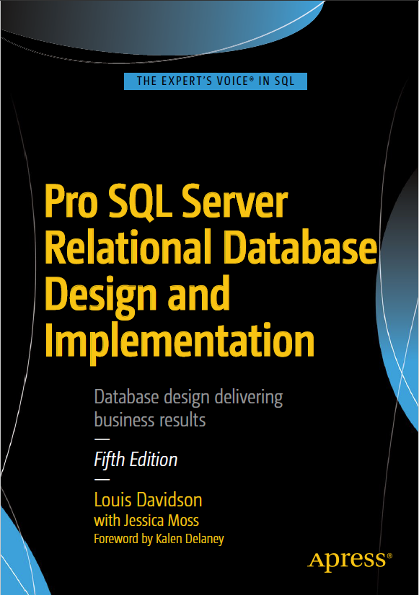
Who am I?
Been in IT for 20-some years
Microsoft MVP 16 Times
Corporate Data Architect
Written 6 books on
database design
  They were technically all versions
  of the same book.
  Always new AND improved!
  They had slightly different titles each time, but (probably) never again!
  Sixth Edition coming later this year
Super Brief Contact Info: DRSQL
  Twitter, Website (.org), Email (@hotmail.com), Github (drsqlgithub)
Notes:
Change it to planning the next version

Slide 3


The Problem of Concurrency

Slide 4
Topics of Discussion
Hardware
Transactions
Connection/Transaction Isolation
The Effect of Timing
Methods of Enforcement

Slide 5

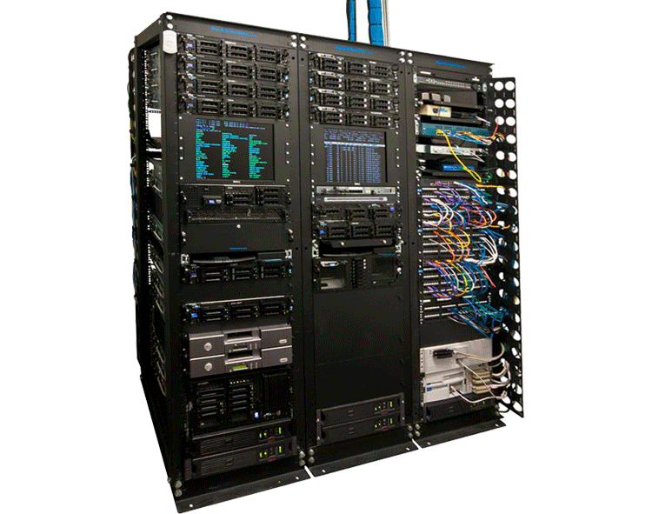
SQL Server Runs On a Lot of Different Hardware
Don’t expect:
To run like:
This Photo by Unknown Author is licensed under CC BY-SA
This Photo by Unknown Author is licensed under CC BY-SA-NC

Slide 6

Transactions
Purpose
  Durability
    Note: ADR (Accelerated Database Recovery) added in SQL Server 2019 to improve rollback times.
  Atomicity
    SQL Server’s concurrency controls are at this level
Nesting Transactions
  Autonomous Transactions – IDENTITY column property, SEQUENCE object
Demo 1 – Basic transactions. Usually cut for time, very simplistic, available in download

Slide 7
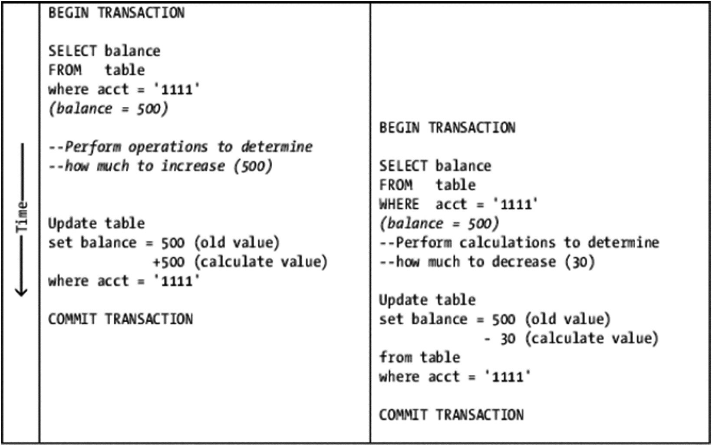
Connection/Transaction Isolation
How can one connection affect another connection?
  Classic Example: Lost Update

Slide 8
Connection/Transaction Isolation
How can one connection affect another connection?
Types of Phenomenon
  Phantom rows - Seeing new rows for same query
  Non-Repeatable Read – Rows vanish or change
  Dirty Read – Seeing data that never may actually exist in a specific form
  Previously Committed Data – Seeing data that no longer exists in the same form, but was consistent at a point in time
You don’t pick and choose, there is a setting TRANSACTION ISOLATION LEVEL that configures what you will allow for your transaction

Slide 9
Isolation Levels and Anomalies Allowed
Standard settings to determine which anomalies we will accept within an active transaction
The isolation levels are:
  READ UNCOMMITTED –Dirty Reads, Phantom Rows, Non-Repeatable Reads
  READ COMMITTED (Typical SQL Server Default) – Phantom Rows, Non-Repeatable Reads
  SNAPSHOT – Previously Committed Data
  (Older data, though a consistent view to a point in time)
  REPEATABLE READ – Phantom Rows
  SERIALIZABLE
Essential to thoughtfully pick the one that matches your needs

Slide 10

The Effect of Time on Concurrency
Synchronous access
Asynchronous access
Time

Slide 11


Synchronous Access - Methods of Enforcement
Locks
Versions

Slide 12


Locks
Tags to tell others you are using a resource
  Note: The following is simplified, will include a list of resources for more detailed information
Resource: Database, Table, Page, Row/Key, Range of Data, Schema, etc
Type:
  Shared – Just looking, not modifying. Tells others they can use a resource, just don’t change it
  Exclusive – (Typically) Used when modifying data
  Update – A type of shared lock that says the connection may modify the underlying data.
    Must be changed to Exclusive to perform modification.
    Compatible with shared locks, not other update locks.
    More info: http://www.sqlpassion.at/archive/2014/07/28/why-do-we-need-update-locks-in-sql-server/
  Stability – Placed to keep you from changing or dropping an object that is in use
Subtype:
  Intent – Placed at higher levels in the resource hierarchy to tell other connections they can’t place an incompatible type
Compatibility:
  Lock types must be compatible to be placed simultaneously
  Full matrix: https://docs.microsoft.com/en-us/previous-versions/sql/compact/sql-server-compact-4.0/ms172925(v=sql.110)
  Deadlocks – Resource stalemate

Slide 13
Lock Compatibility
Compatible locks can coexist with other locks of the same type for different connections
Incompatible locks block
For more details, including more details on Range Lock compatibility:
  https://docs.microsoft.com/en-us/sql/relational-databases/sql-server-transaction-locking-and-row-versioning-guide?view=sql-server-ver15
Mode | IS | S | U | IX | SIX | X
Intent shared (IS) | X | X | X | X | X
Shared (S) | X | X | X
Update (U) | X | X
Intent exclusive (IX) | X |  |  | X
Shared with intent exclusive (SIX) | X
Exclusive (X)

Slide 14

Why Query Optimization Matters
Locks are applied to rows you touch
This is not just the rows you actually output or modify
Using an index can reduce the number of rows that need to be touched, and hence, locked

Slide 15
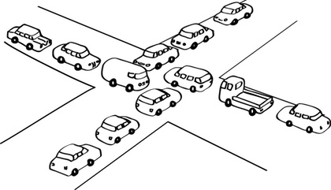
Deadlocks
Connections have incompatible needs for resource that cannot be resolved
  Transaction X has resources Transaction Y needs and needs resources Transaction Y has
  Transaction Y has resources Transaction X needs and needs resources Transaction X has
  So one transaction has to be killed (gruesome)
One of the least of your worries as a DBA
  Handled by redoing the operation
  Making it a larger worry for programmers
Proper Coding Of Deadlock resolution prepares you for Memory Optimized Tables.
This Photo by Unknown Author is licensed under CC BY-ND

Slide 16

Demo – Synchronous Concurrency Collisions With Locks
Demos 2
Using:
SQL Server 2019
On a Intel NUC, 32 GB, 1TB Nmve, 1TB SSD

Slide 17
Multi-Valued Concurrency Controls (MVCC)
Connections work off of the version of the row when the transaction starts
Isolation levels are implemented lockless, rather conflicts are checked at COMMIT TIME
True Version Based Concurrency Controls are often referred to as Optimistic Concurrency Controls
  It works best with rare modification collisions
  Small, short transactions are generally better for this model
  Makes integrity checks far more difficult
  Lock based concurrency is often referred to as the “pessimistic” model

Slide 18
Multi-Valued Concurrency Controls (MVCC)
Every modification to a row results in a new physical resource
The new physical resources are timestamped to their effective time
  UPDATE operations are an INSERT a new row for the future, UPDATE old row with timestamps for the past
  DELETE operations are just an UPDATE of the exiting row with timestamps for the past
  Cleanup processes remove expired rows (timestamps that no transactions need)
There are two versions currently implemented in SQL Server
  Memory Optimized Tables (2014+) – Physical structures completely based on versions
    Supports SNAPSHOT, REPEATABLE READ, SERIALIZABLE Isolation Levels
  On-Disk Tables (2005+) –Makes copies of rows in tempdb for read versions, still uses locks for write collisions.
    Not a full snapshot implementation, still uses locks
    Use SNAPSHOT Isolation Level for the transaction level
    READ COMMITTED w/ READ_COMMITTED_SNAPSHOT DB Setting changes READ COMMITTED to read around locks to a snapshot

Slide 19
Hash Index Simplified With Row Versions
TableNameId | Country | OtherColumns
1 | USA | Values
2 | USA | Values
3 | Canada | Values

Slide 20
Hash Index – After Row Update
TableNameId | Country | OtherColumns
1 | USA | Values
2 | Canada | Values
3 | Canada | Values

Slide 21
Big Demo – Synchronous Concurrency Collisions with MVCC
Demo 3
Using:
SQL Server 2019
On a Intel NUC, 32 GB, 1TB Nmve, 1TB SSD

Slide 22
Asynchronous Considerations
Typical Flow
  Two Users Fetch Data
  Both wish to update data based on what they currently believe is true (and may still be)
  Goal: No one loses any information
  Time separation may be many hours (cached data)
    Or just a few microseconds (lock)
Common patterns of solution
  Chaos – Last writer wins
  Optimistic Locking – Check cached data to see if it is still the data you had originally
    Compare All (Or Some) Data (Can use a hash of the data if sufficiently complex)
    Compare some automatically maintained data (Rowversion (aka Timestamp), Row Last Modified Time controlled by Trigger, Client Managed Value)
  Pessimistic Locking – Some form of user created lock to keep others out from reading rows…concurrently?
  Hybrid of all Three – Example: How to deal with updating 100s (of thousands?) of rows?

Slide 23
Wrapup - The problems are complex
Mostly the issue is one of proper design, testing (both with slower transactions and in labs at large scale), and probability/dumb luck
Your designs must consider:
  Cost of Integrity Fail
  Throughput
  Cost of Integrity Fail
  Likelihood of collisions
  Cost of Integrity Fail
Hopefully it is clear what is most important

Slide 24
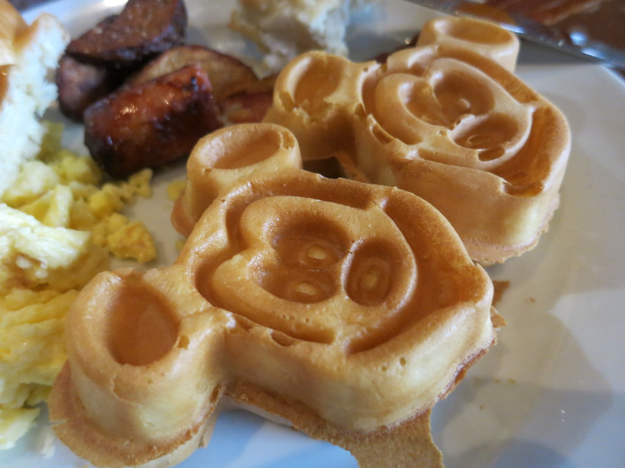
Cost of Integrity Fail – “What if?” (Scenario 1)
Two people are travelling to Orlando via train, and both order Mickey Waffles from two different wait persons, but there is only one order of waffles still available
Verdict: Annoying but not life threatening
This Photo by Unknown Author is licensed under CC BY

Slide 25

Cost of Integrity Fail – “What if?” (Scenario 2)
You are building a train management system. Train A is given access to Location L on Track 1 at 11:30 AM, and Train B is given access to the same Location at the same time going in the opposite direction.
Verdict: You may not be employed for long, and may perhaps be in prison soon.
Note: The “What if?” test ought to be applied to all of your designs

Slide 26

Questions? Comments?

Slide 27
DRSQL More Complete Contact Info
Louis Davidson - louis@drsql.org
Website – http://drsql.org <-- Get all of my slides/code here
Twitter – http://twitter.com/drsql (@drsql)
Github – https://github.com/drsqlgithub
  https://github.com/drsqlgithub/Presentation-Files--Matters-Of-Concurrency
Simple Talk Blog – What Counts for a DBA
http://www.simple-talk.com/community/blogs/drsql/default.aspx
Notes:
[twitter] Slides will be on drsql.org in the presentations area for this and the keynote as soon as I can get them out there. @rmtechtrifecta [/twitter]

Slide 28
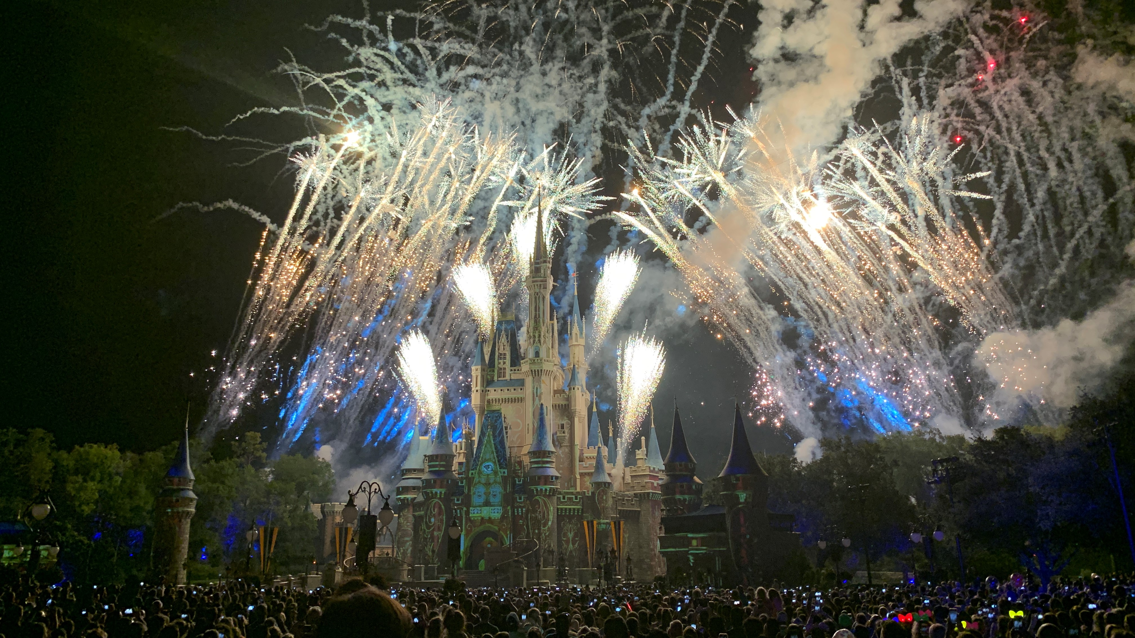
Thank You!
Copyright @disneypicaday (aka me!)

Slide 29

Thank You!

